Slide 1
Quinn Research Group Meeting
January 23, 2019

Slide 2
Group Members
Mojtaba Fazli (Ph.D.)
Bahaa AlAila (Ph.D.)
Rajeswari Sivakumar (M.S.; remote)
Christian McDaniel (M.S.)
Weiwen Xu (M.S.)
Andrew Durden (B.S. turned M.S.)
Zane Page (B.S.)
Sonia Rao (B.S.)
Meekail Zain (B.S.)

Slide 3
Group Members
Mojtaba Fazli
Bahaa AlAila
Rajeswari Sivakumar (graduating!)
Christian McDaniel (graduating!)
Weiwen Xu (graduating!)
Andrew Durden (graduating!)
Zane Page
Sonia Rao
Meekail Zain

Slide 4
Spring 2019 Schedule
January 23 (today)
January 30
February 6
February 13
February 20
March 6
March 20
March 27
April 3
April 10
April 17
April 24-25 (other)
Notes:
February 27: possible travel in D.C.
March 13: spring break! (also my birthday)
April 3: AnacondaCON (if anyone is even planning to go)
Emphasis:
- Mojtaba (practice for IEEE, prospectus)
- Christian (practice for defense)
- Raj (practice for defense, SciPy)
- Andrew (practice for defense, SciPy)

Slide 5
Expectations
Excellence in Research
Clear objectives (set goals)
Self-motivation (keep trying things)
Collaboration (talk to each other)
Continued progress (even sideways)
Excellence in Communication
Writing & Editing (preprints, papers)
Blogging
Documenting (in-code, READMEs, wikis)
Open Science (group GitHub)

Slide 6
Resources
Codename “LittleJohn”
20 nodes: 12 cores, 128GB memory, 2TB HDD each
1 node: 12 cores, 16GB memory, 40TB HDD
1 node: 2x TITAN GPU
Google Cloud Platform ($300 free for signing up!)
Amazon Web Services (currently no research credits, sorry ☹ )
GACRC: https://wiki.gacrc.uga.edu/wiki/Main_Page
I have a lab account—let me know if you want/need access, and I’ll sign you up

Slide 7
Conference Venues
Interested in traveling? Practice speaking in front of a crowd? A chance to network with the experts?

Slide 8
Conference Venues
Neural Information Processing Systems (NeurIPS)
Vancouver, CA
Early December, 2019
Submission deadline: ~May 2019
https://neurips.cc/
~20% acceptance rate

Slide 9

Conference Venues
IEEE Data Science and Advanced Analytics (DSAA)
Washington, D.C.
October 5-8, 2019
Submission date: May 5
Acceptance rate: ~20%
http://dsaa2019.dsaa.co

Slide 10

Conference Venues
ACM SIGKDD
Anchorage, Alaska
Tippy-top data science conference
Submission deadline: Feb 3
Conference dates: Aug 4 - 8
https://www.kdd.org/kdd2019/

Slide 11

Conference Venues
International Conference on Computer Vision
Seoul, Korea
October 27 - Nov 2, 2019
Paper Registration: March 15
Paper Submission: March 22
http://iccv2019.thecvf.com

Slide 12
Conference Venues
SciPy
Always in Austin, Texas
Abstract deadline: Feb 11
Paper does NOT need to be ready; this is just an abstract!
https://scipy2019.scipy.org/
Had two papers accepted to SciPy 2018!

Slide 13
Conference Venues
Southern Data Science Conference 2019
Atlanta, GA
April 11-13, 2019
Abstracts due: Jan 24
https://www.southerndatascience.com/
Had two posters accepted to SDSC 2018!
(Full disclosure: I’m on the SDSC Advisory Board)

Slide 14
Google Summer of Code 2019
https://summerofcode.withgoogle.com/
Participating organizations announced on Feb 26
Will move fast after that!
Student Application Period: March 25-April 9
Need to be familiar with potential projects before then!
Feb 26 – March 25 period considered crucial for students to interact with orgs

Slide 15
Journals and preprints
Go through multiple rounds of review, really polish your paper, which perhaps started its life as a preprint

Slide 16
Journals
The Journal of Open Source Software (JOSS) (http://joss.theoj.org/ )
eLife
IEEE
Biomedical and Health Informatics (3.451)
Neural Networks and Learning Systems (6.108)
Image Processing (4.828)
Medical Imaging (3.942)
Computational Biology and Bioinformatics (1.955)
ACM
Knowledge Discovery from Data
Computational Biology and Bioinformatics
PLoS
ONE
Computational Biology
PeerJ
Computer Science
Preprint

Slide 17
Preprint servers

Slide 18
REU (Research Experience for Undergrads)
If you
are an undergraduate
are NOT in your final year
are potentially interested in pursuing research after graduating
have never been to Pittsburgh and/or are interested in visiting
TECBio REU at University of Pittsburgh
May 20 through July 26
$5,750 stipend + housing + travel
Applications due Feb 11, 2019
https://tecbioreu.pitt.edu/

Slide 19
What to do next

Slide 20
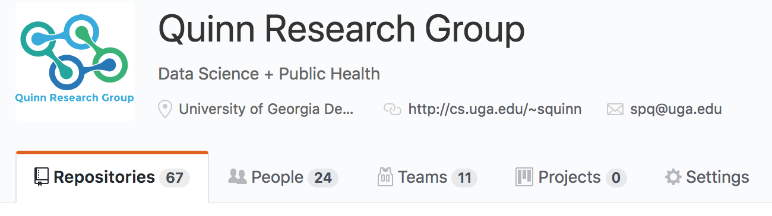
Connect to the QRG Github
Send me your GitHub username

Slide 21
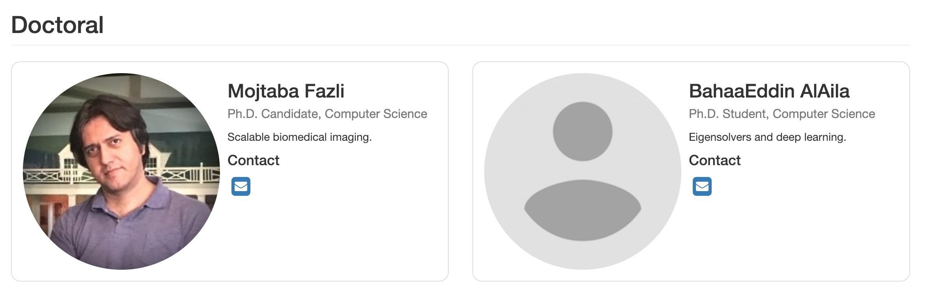
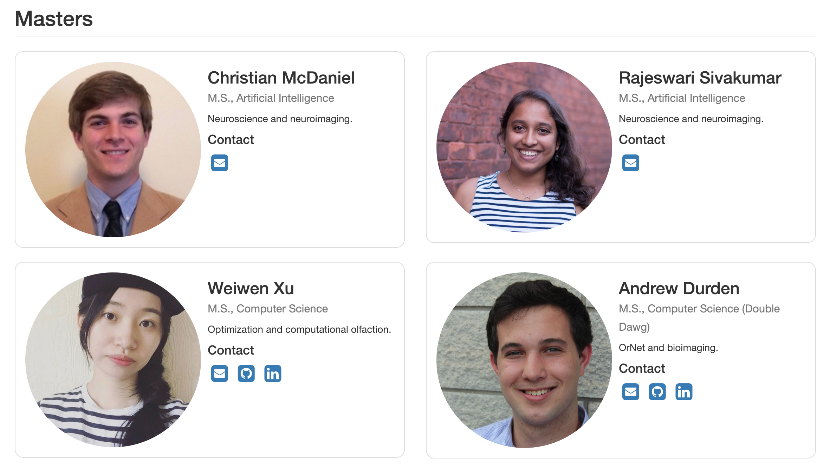
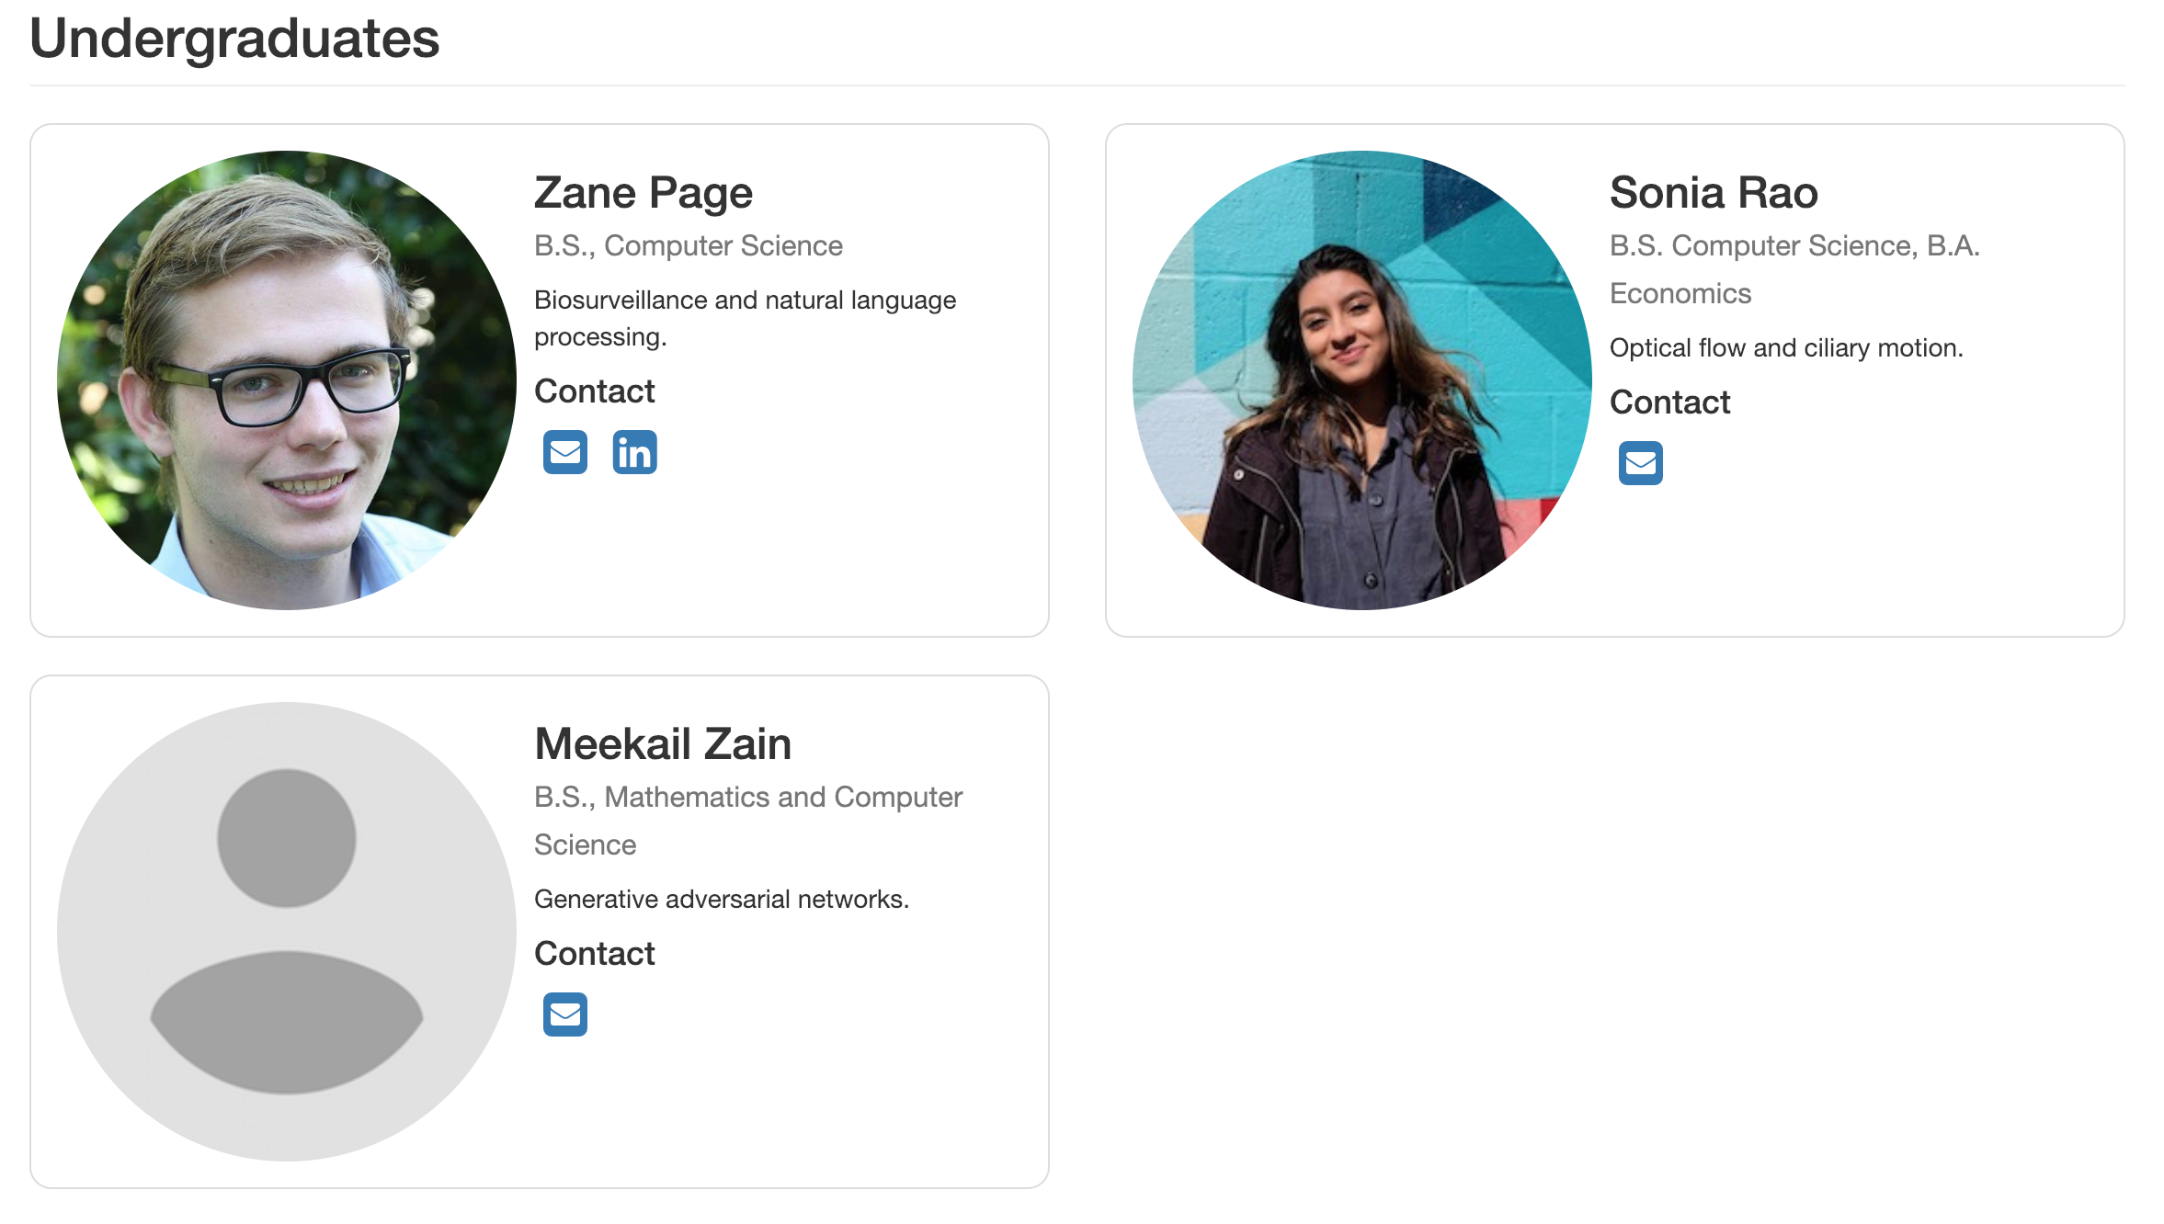
Pictures + Info
https://quinngroup.github.io/people.html
Email address, GitHub, social network handles, etc

Slide 22
When it’s your turn to give a talk
(yep, we’re putting presentation materials on GitHub now!)
Clone the repository
Go into the folder for the proper year (so for you, this would be 2019)
Create a new folder there in the format: <month><day>_<name>_<summary>
Create a README file with a summary of your talk
Include all the materials (pptx, paper, notebooks, etc) in that folder (NOT raw data though)
From inside that directory: add, commit, and push everything back out!

Slide 23
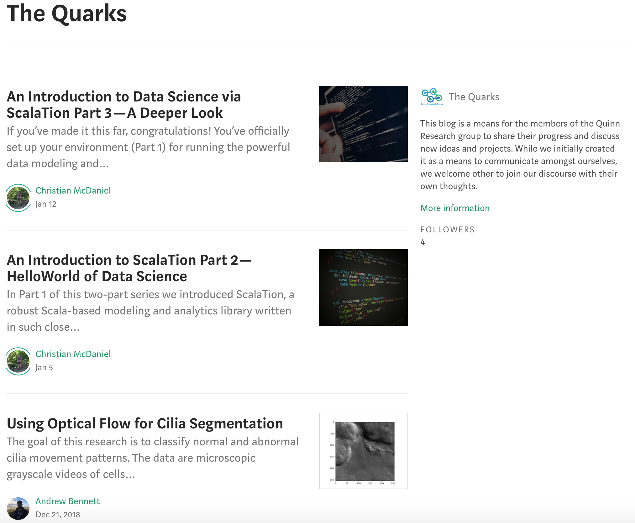
Sometime this semester
Publish a blog post on our “Quarks” Medium account! https://medium.com/the-quarks
Can be on anything!
Some software you used (Christian’s posts)
The latest results of your research (Andrew’s post)
A cool paper you came across
[YOUR IDEA HERE]
Award for the most-shared blog post!

Slide 24
Every Saturday or Sunday
Send me a message over Slack or email with the following bits of information:
What you accomplished in the past week
Any roadblocks you ran into or problems you had with #1
What you plan on doing in the coming week
I’ll try to remind everyone, but please take it upon yourself to do this!
I refer to these points in our individual meetings each week

Slide 25
Always
Push your code to GitHub
Document everything
Make a good README
Include comments in your code
Use the ticket system when you run into problems or need to remind yourself to do something, or even when you just get a crazy idea
Make notes in the GitHub wiki (could later form the basis for a paper or preprint)
Ask for help when you need it
Have fun with your work--and if it’s not fun, let me know

Slide 26
Questions?

Slide 27
Old slides

Slide 28
Kaggle
https://www.kaggle.com/c/rsna-pneumonia-detection-challenge

Slide 29
Kaggle 2018 Data Science Bowl
Nuclei Segmentation
https://www.kaggle.com/c/data-science-bowl-2018
April 9: Entry deadline
Talk about tailor-made for us! ☺

Slide 30

Conference Venues
MICCAI
Granada, Spain
Will be September 16 - 20, 2018
Submission deadline usually ~February
Also lots of A+ workshops with submission deadlines in the summer months
http://www.miccai2018.org/

Slide 31
Conference Venues
IEEE International Symposium on Biomedical Imaging (ISBI)
Venice, Italy
April 8-11, 2019
Submission deadline: October 9, 2018
https://biomedicalimaging.org/2019
~20% acceptance rate
Had two papers and a poster accepted to ISBI 2018!

Slide 32

Conference Venues
CVPR
Long Beach, CA
June 15 – 21, 2019
Submission deadline: November 16, 2018
http://cvpr2019.thecvf.com/
Acceptance rate: ~30%
Most likely great workshops with ~early-to-mid spring deadlines

Slide 33

Conference Venues
International Conference on Machine Learning
Long Beach, CA
June 10-15, 2019
Abstract deadline: Jan 18
Full paper deadline: Jan 23
https://icml.cc/

Slide 34
Conference Venues
The ACM Conference on Bioinformatics, Computational Biology, and Health Informatics
Boston, MA
August 21-24, 2017
April 10, 2017
http://acm-bcb.org/
~30% acceptance rate

Slide 35
And now for something completely different

